Slide 1
Coin Recognition
Martin Schacherl, Christoph Fuchs,
Andreas Hengl, Roman Hochstöger
Image Understanding LU
Pattern Recognition and Image Processing Group
Institute of Computer Graphics and Algorithms
Vienna University of Technology

Slide 2

Difficulties regarding Coin Recognition
Viewpoint/perspective
Coin partially overlapped (by other coin)
Rotation
Frontside/backside of the coin
Euro Coins: Different countries – different backsides
(Flash-) Light reflected by coin
Impurities
Please put an overview slide!

Slide 3
Solution
Segmentation: Hough-Transformation
Edge Detection
BP Network
  Input: Fourier Coefficients - SIFT
What is BP and SIFT, do not use acronyms whithout defining them beforehand
You can do that by a citation for e.g.

Slide 4

Tasks/Work Plan
Literature Research: Andreas
Presentation/Handin/Report: Martin
Coding (Segmentation): Roman/Christoph (done)
Neural Network for recognition: All, end of december
Coding (SIFT): Andreas, end of december
Comparison of methods: All, end of december
Extra time for algorithm improvements: All, january
Report/presentation: Martin, january

Slide 5
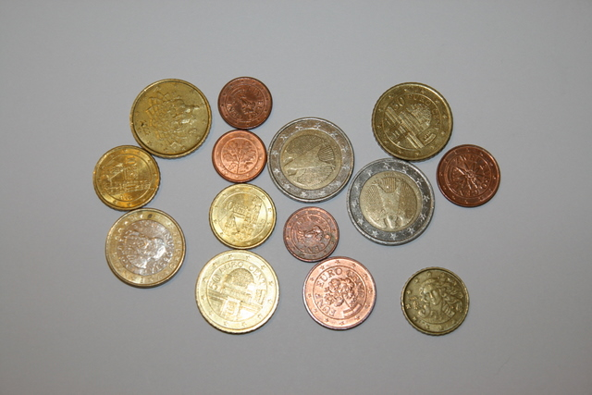
Preliminary Results
Segmentation: Hough-Transformation
Is this done autmatically?
Goal: Calculation: 2x€2+1x€1+3x€0,50+3x€0,10+1x€0,05+1x€0,02+3x€0,01=€6,90-

Slide 6

Literature
CHEN Cai-ming et al., „A coin recognition system with Rotation invariance“, Proceedings of the 2010 IEEE International Conference on Machine Vision and Human-machine interface, pp. 755-757, 2010
KAMPEL M., Zaharieva M., „Recognizing ancient coins based on local features“, Proceedings of the 4th international symposium on visual computing, pp. 11-22, 2008
MITSUKURA Yasue et al., „Design and evaluation of neural networks for Coin recognition by using GA and SA“, Proceedings of the IEEE-INNS-ENNS International Joint Conference on Neural Networks, pp. 178-183, 2000

